Slide 1
2019-2020
Special Education Report
Notes:
Good Evening. Thank you for your time this evening.
Our hope is by the end of the night you will have some general information on our current Special Education data and programing.

Slide 2
Special Education Department
Early Intervention (EI) Ages Birth - 3
Section 504 Rehabilitation Act Ages 5-21
Transition to CPSE
Committee on Preschool Special Education (CPSE) Ages 3-5
Committee on Special Education (CSE) Ages 5-21
Support of Transition services post High School
Notes:
This evening we are going to focus on the world of Special Education.
Special Education is divided into five areas.
Early Intervention (EI) Ages Birth – 3 services are provided by the county
When they transition to CPSE we as a school district work in a partnership with Essex county to ensure the students in need of special education services are still receiving the services
Committee on Preschool Special Education (CPSE) Ages 3-5 . The partnership continues with the CPSE students. Though services are paid for by the county at this point we are participating in their services and have a relationship with the families. In Boquet this relationship is enhance due to our UPK program. As soon as the student turns 3 we have the ability to register them in Early Bridges and the students are able to receive their special education services in the program.
Committee on Special Education (CSE) Ages 5-21. These are our kindergarten to HS students and families.
An IEP is a comprehensive document that essentially serves as a blueprint or roadmap for a child with special education services. It includes comprehensive information about a child’s diagnoses, needs, recommended services, and accommodations, and pretty much anything else pertaining to the child’s unique identifying factors. It’s formal and legally binding, and is the result of a comprehensive evaluation.
Section 504 Rehabilitation Act Ages 5-21 . These are also our kindergarten to HS students and families.
A 504 plan is also a map or plan, but it deals specifically with how a child will be learning within the school, and does not equate to a diagnosis or even formal special education services.

Slide 3
Special Education Department
Notes:
Overseeing the Special education program means ensuring the systems and processes are being followed.
Focus on Early Intervention (EI) Ages Birth - 3
Transition to CPSE
Committee on Preschool Special Education (CPSE) Ages 3-5
Committee on Special Education (CSE) Ages 5-21
Section 504 Rehabilitation Act Ages 5-21

Slide 4
Special Education Data Reporting
Notes:
Another important piece of overseeing special education is the data collection for the state and for our district.
This year we are reporting on Indicator 11: Child Find to the state.
As of April 2012, the State’s established timeline to complete the initial evaluation is 60 calendar days from the date of parental consent to evaluate for preschool and school-age students. This indicator reports the percent of children who were evaluated within 60 days of receiving parental consent for initial evaluation.
As a district we also use tiered level of data. Global district data, grade level data and individual student data.

Slide 5
2019-2020 Classification Data
CPSE
CSE
65 In District Students
19 Out of District Students
504
39
5
Total BVCS Enrollment:
460
504 Classification Rate: 8%
CPSE + CSE = 89 Students with Disability.
Classification rate: 19%
5
84
128
39
27.8% of students at Boquet Valley Central School have an IEP or a 504.
Notes:
This is a Glance at the Demographics of 2019-2020
Keep in mind as you are also looking at Section 504 numbers which are not counted by the state.

Slide 6
2020-2021 To Date Classification Data
CPSE
CSE
63 In District Students
16 Out of District Students
504
37
6
Total BVCS Enrollment:
458
504 Classification Rate: 8%
CPSE + CSE = 89 Students with Disability.
Classification rate: 19%
6
79
122
37
26.2% of students at Boquet Valley Central School have an IEP or a 504.
Notes:
This is a Glance at the Demographics 2020-to present day
Keep in mind as you are also looking at Section 504 numbers. They are counted as general education students not SPED.

Slide 7
Notes:
This provides the data as if Boquet Valley was together for the last three years. It shows that our numbers have not fluctuated drastically.

Slide 8
Classifications at a Glance
2019-2020
2020-2021
Notes:
These percentage are from the total number of students with IEPs excluding the 5 CPSE students.
The 2020-2021 chart also include the percentage for hearing impairment. A new service for this school year.

Slide 9
Area Schools’ Current Classification Rate
Notes:
This is the reported rate for some of our neighboring school districts.
Please know these are not formal classification rates since the formal rate comes from BEDS day data. This provides us with a perspective of how we fall in the region

Slide 10
Special Education Department Staffing
Service Providers
Director of SSS, 504, CSE and CPSE Chair | 1 Full time
Special Education Teachers | 8 Full time
Teaching Assistants | 9 Full time
Aides | 4 Full time
Speech Therapists | 2 Full time
Psychologist | 1 Full time
School Counselors | 3 Full time
Occupational therapist | BOCES Itinerant 1.0
Physical Therapist | BOCES Itinerant 5.6
Teacher of the Visually Impaired | Contract
Teacher of the Deaf | BOCES itinerant contract
Notes:
Current Special Education department staffing

Slide 11
Continuum of Service
Residential or Home/Hospital Instruction
Special Day School (Parsons, Oak Hill)
BOCES- Separate Setting, BOCES Public Setting
Special Class (8:1:1, 12:1:1, 15:1:1)
Regular Classroom with Special Education Services (Integrated Co-Teaching)
Regular Classroom with Special education Resource Room
Regular Classroom with Special Education Services ( Related Services and/or Consultant Teacher)
More Restrictive
Notes:
At this time I would like to discuss the Determining Placement
Schools deliver special education services inside or outside the general education setting. Testing data, classroom-based achievement, and parental input all factor into the placement decision. Federal and State law requires that students be placed in the least restrictive environment (LRE) that meets their needs and that school districts provide a continuum, or range, of placement options. This ensures appropriate exposure to the curriculum as well as maximum interaction with non-disabled peers.
It has to be available though not in the school district. At this time I would like to Introduce you to 3 of our Special education teachers.
Sam Meachem
Marie Williams
And Aubrey Pulsifer.
Each of them will present on their grade level programing.

Slide 12
Elementary Special Education Programing
Wilson Reading System
SRA Corrective Reading Decoding
SRA Corrective Reading Comprehension
SRA Corrective Math Concepts
Reading Mastery A- Grade 4
WonderWorks- Grade 5
Notes:
Sam Meachem

Slide 13
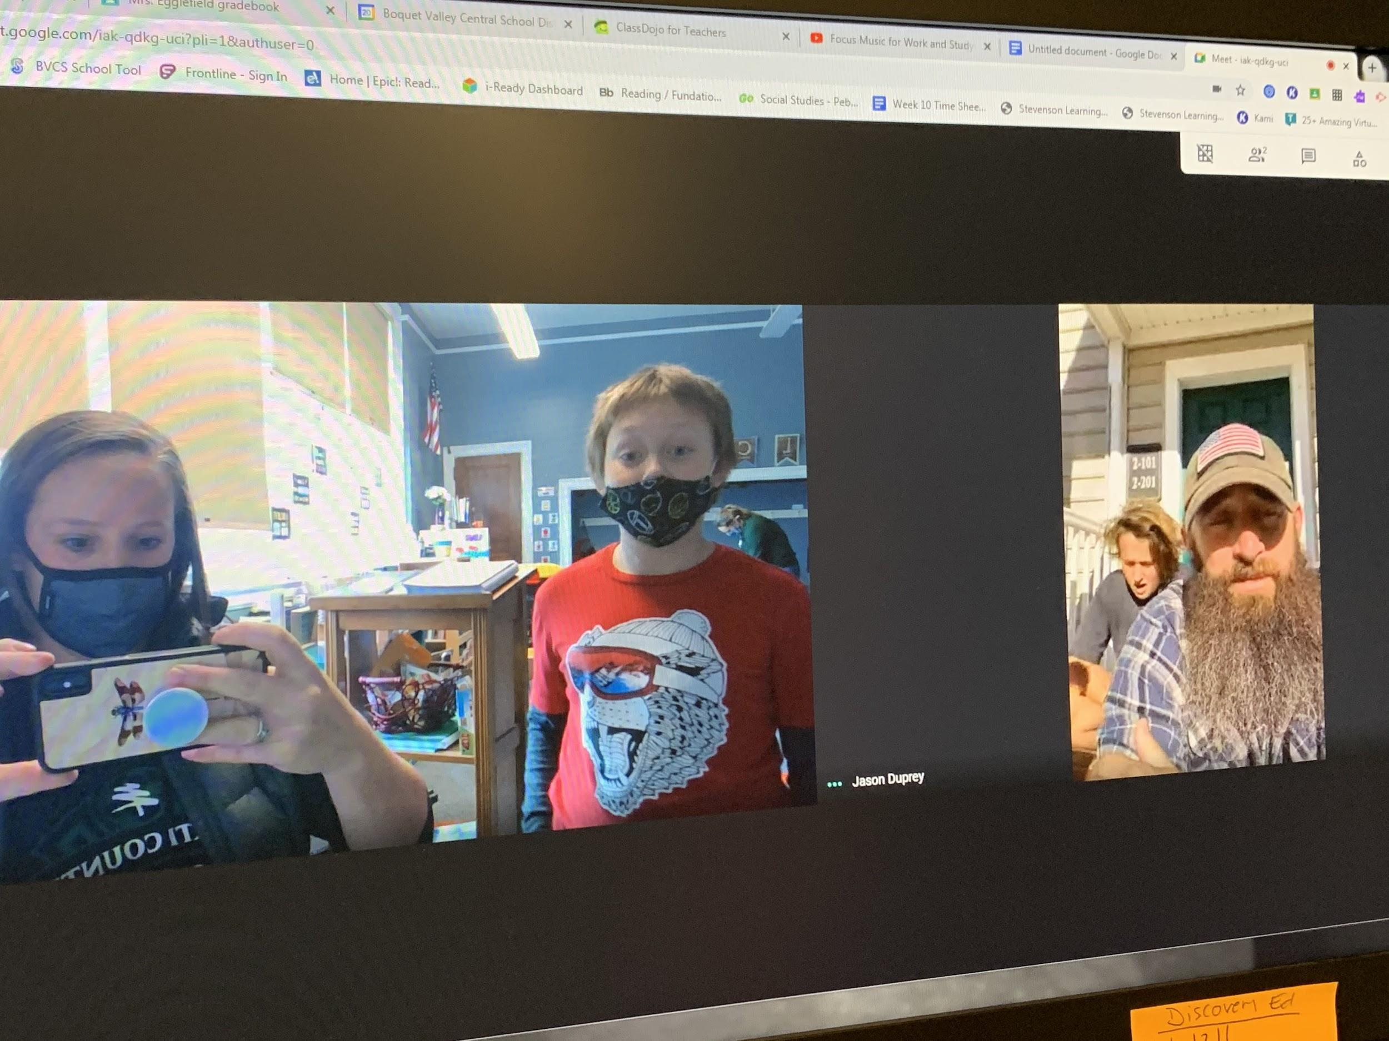
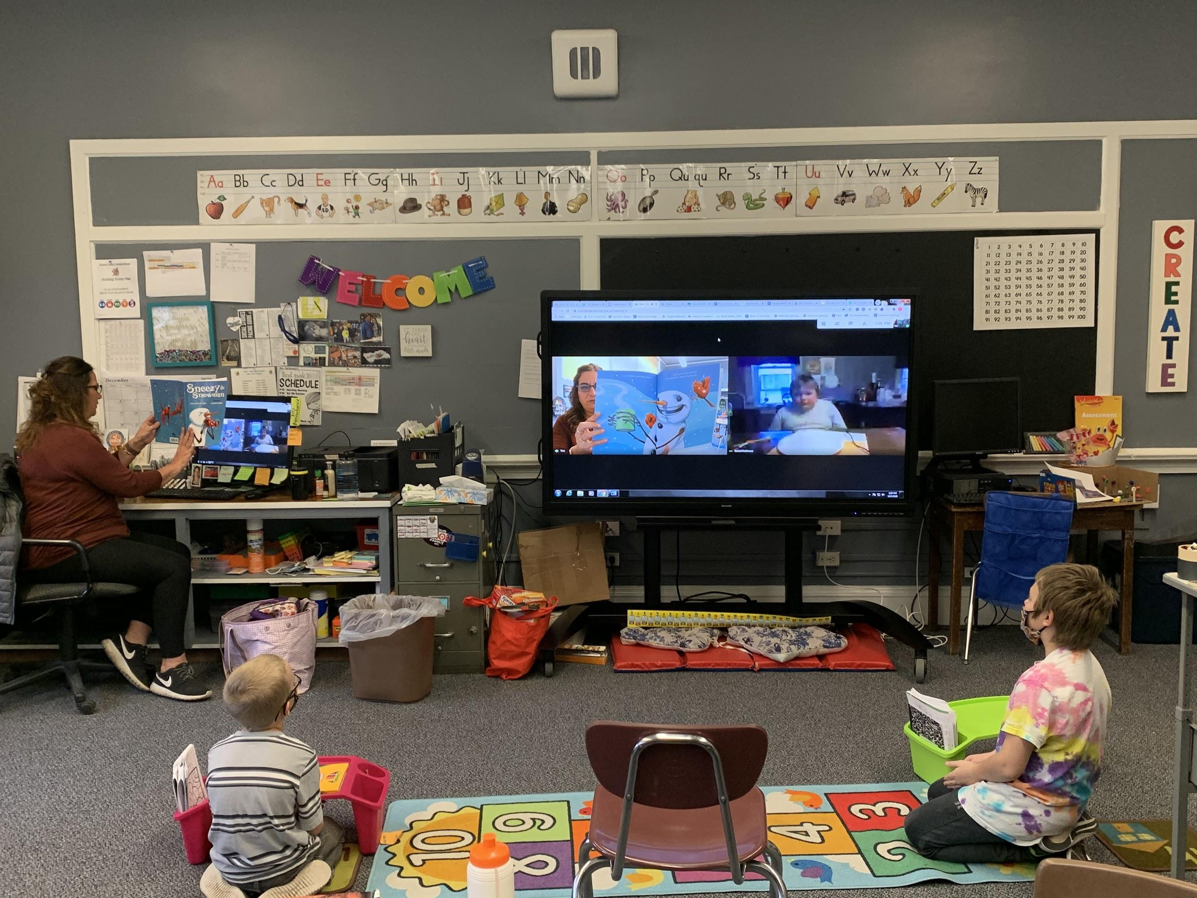
8:1:1 classroom
There are currently 3 students enrolled in our 8:1:1 program. 2 students are preparing to transition to the 12:1:1 program next year.
Google Meet With A Veteran
Class Read Aloud
Notes:
Marie Williams

Slide 14
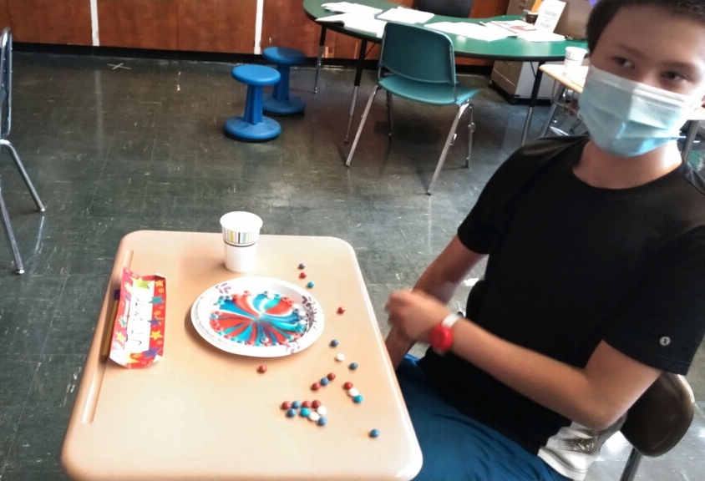
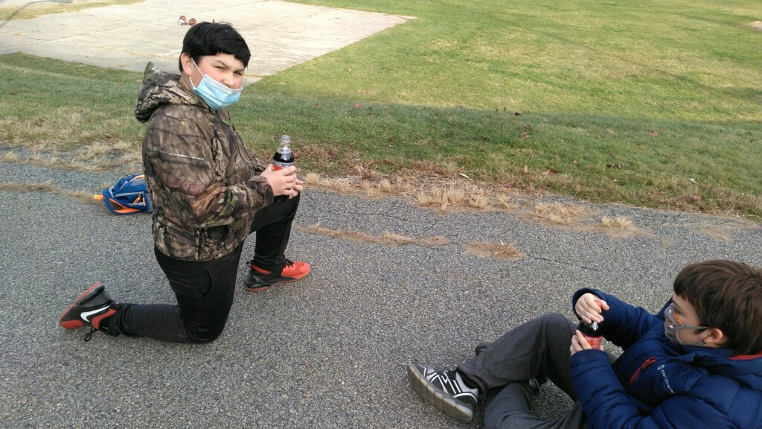
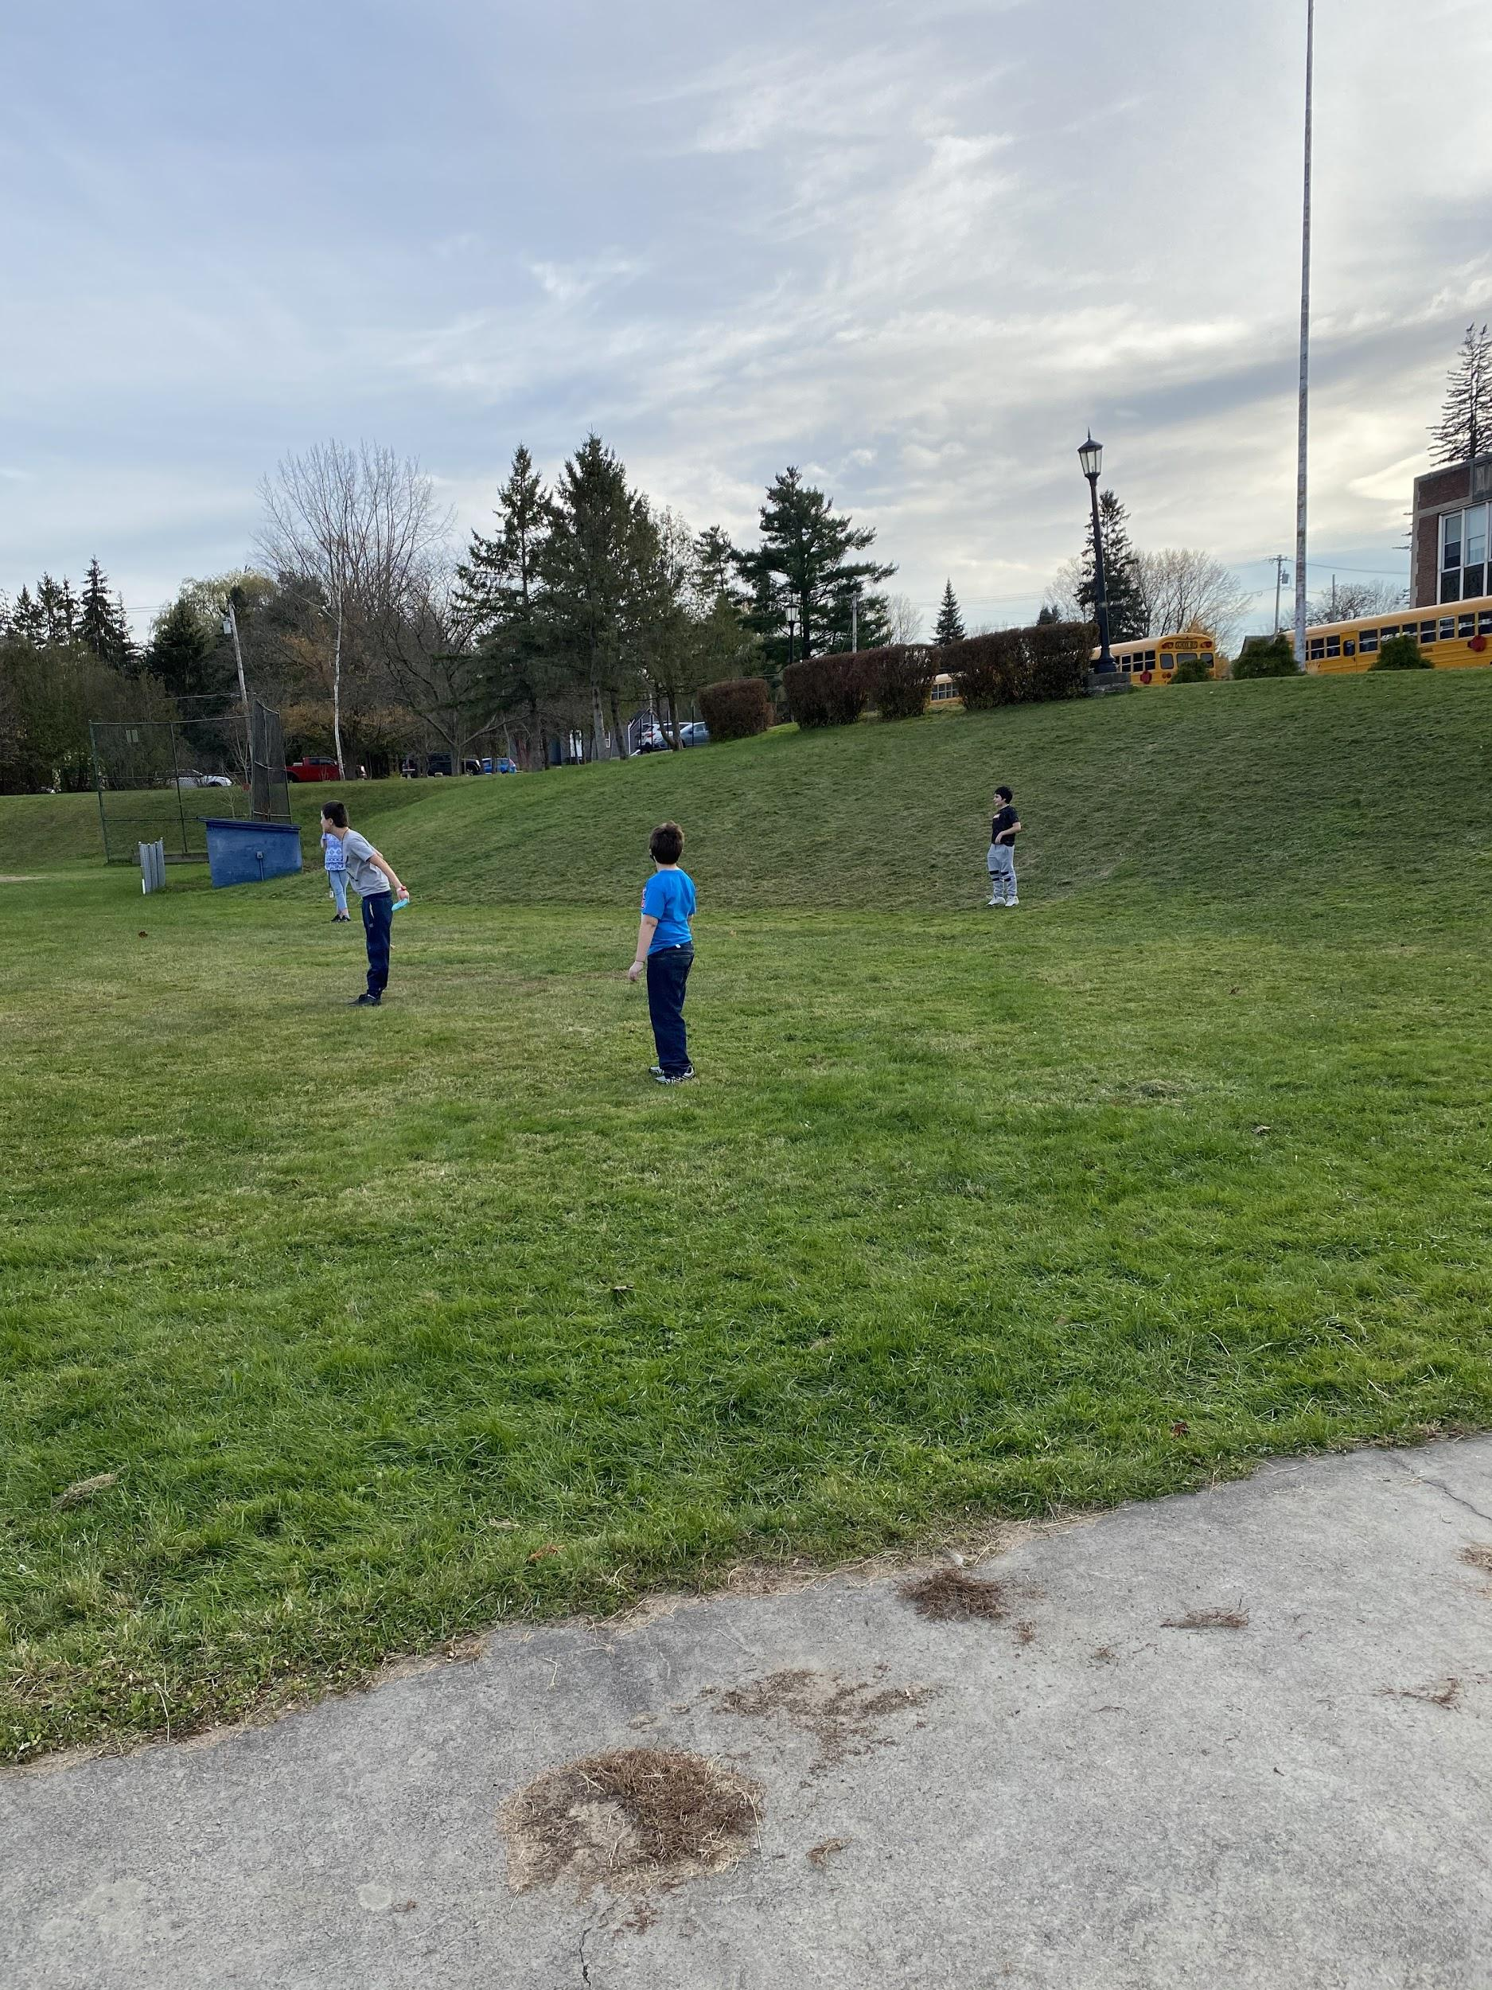
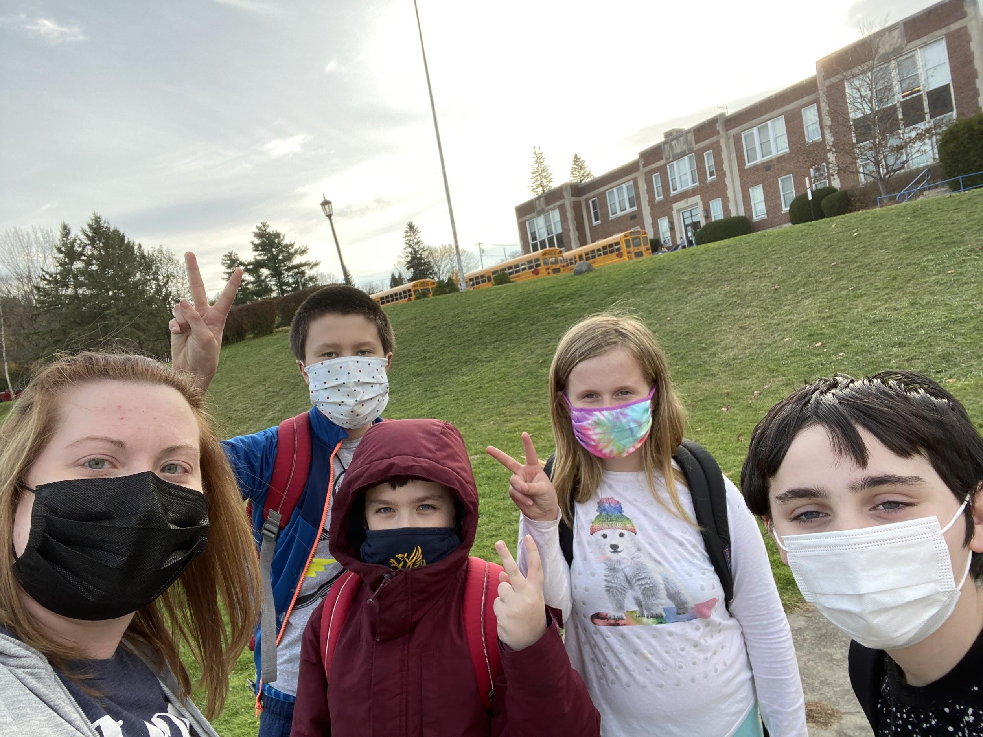
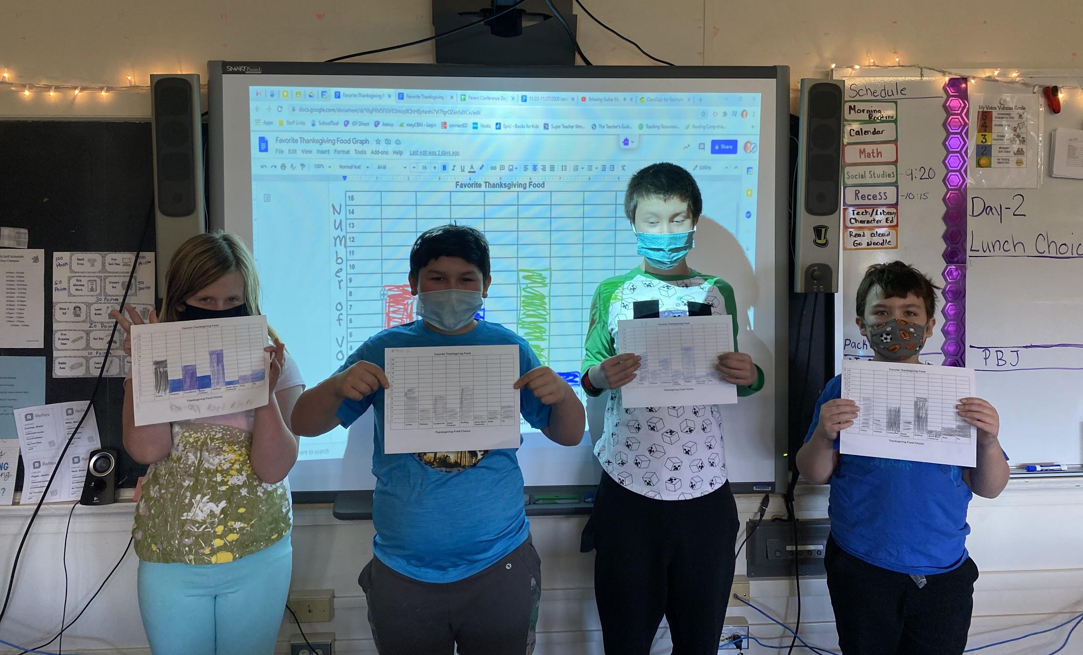
12:1:1 Classroom
There are currently 4 students enrolled in our 12:1:1 program. These 4 students are in 5th grade and will need to transition to a middle school 15:1:1 life skills classroom next fall.
Fun Friday Science Experiments
Graphing Our Favorite Thanksgiving Dishes
Outside Games For Fun Friday
Notes:
Marie Williams

Slide 15
Secondary Special Education Programing
Middle School
High School
Corrective Reading B1
Corrective Reading (Fast Track)
Just Words
Wilson
Corrective Reading B2
Read to Achieve (Narrative/Content Area Text)
Just Words
Notes:
Aubrey Pulsifer

Slide 16
Questions

Slide 17
THANK YOU!

